Slide 1
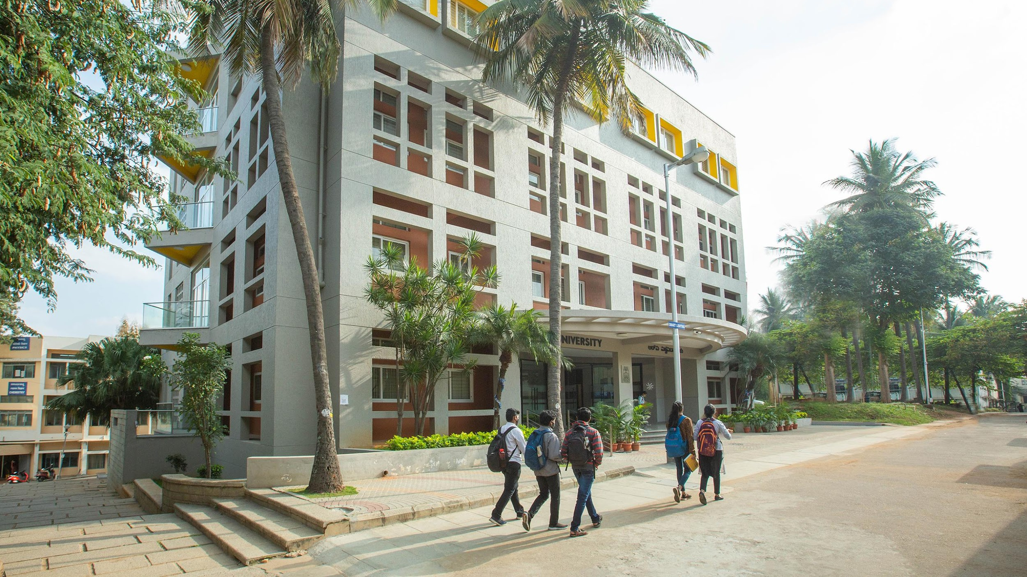
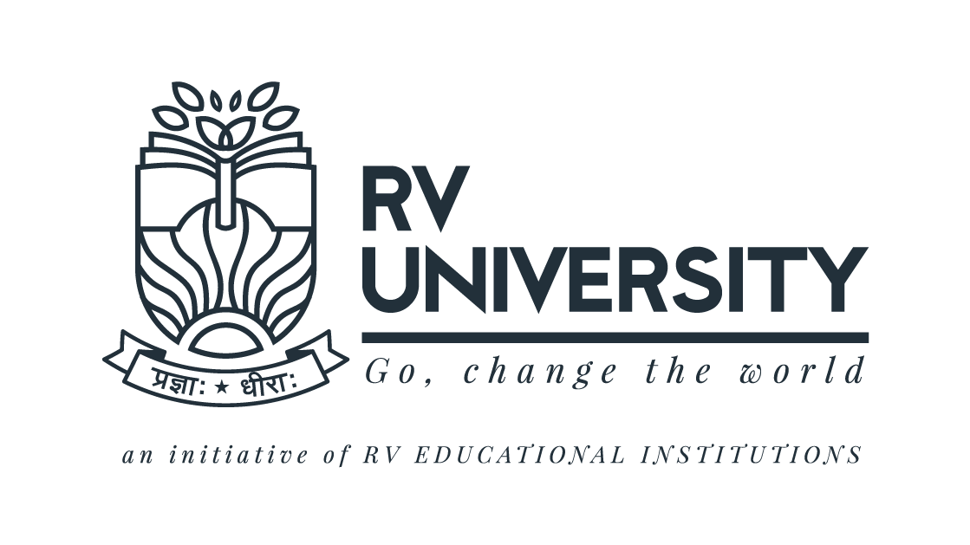
SMART FOOD RECOGNITION AND PERSONALIZED DIET PLANNER
NUTRITRACK
Name: Mohammed Ikram
USN: 1RVU22BSC054

Slide 2
PROBLEM STATEMENT
Current diet trackers depend on manual input or barcode scanning, which doesn’t work for homemade or complex meals. Existing apps also lack personalized meal planning and struggle with accurate portion estimation. These limitations reduce accuracy, convenience, and user engagement.

Slide 3
PROPOSED SOLUTION
NutriTrack integrates YOLOv8 for real-time food detection, a nutrition database for calorie/nutrient estimation, and AI models for personalized meal suggestions. It automates the entire process from image capture to diet tracking, reducing user effort and improving accuracy
Key Features
Real-time Image-Based Food Recognition
Calorie and Macro/Micronutrient Estimation
Personalized Diet Recommendations
Progress Tracking & Goal Customization

Slide 4
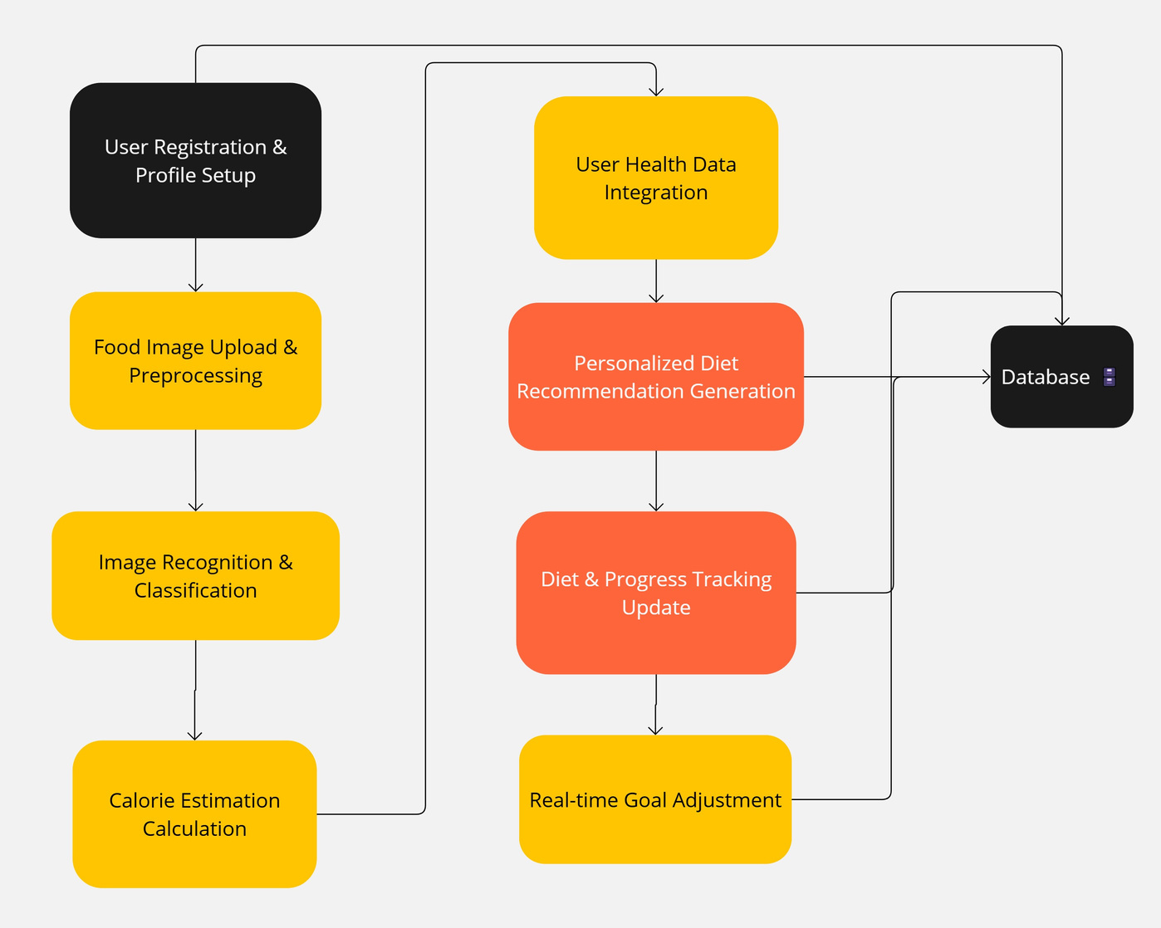
ARCHITECTURE

Slide 5
METHODOLOGY / IMPLEMENTATION
Image Acquisition Users capture or upload meal images via camera or file upload.
Food Detection & Recognition YOLOv8 detects and recognizes multiple food items in real-time, trained on a diverse food dataset.
Calorie & Nutrient Estimation Retrieves calories and nutrients from a database. YOLO bounding boxes help estimate portion sizes accurately.
Personalized Diet Recommendation AI generates meal plans based on age, weight, health conditions, fitness goals, and dietary preferences.
Progress Tracking & Goal Customization Tracks intake over time, supports custom goals, and adapts recommendations based on progress.

Slide 6
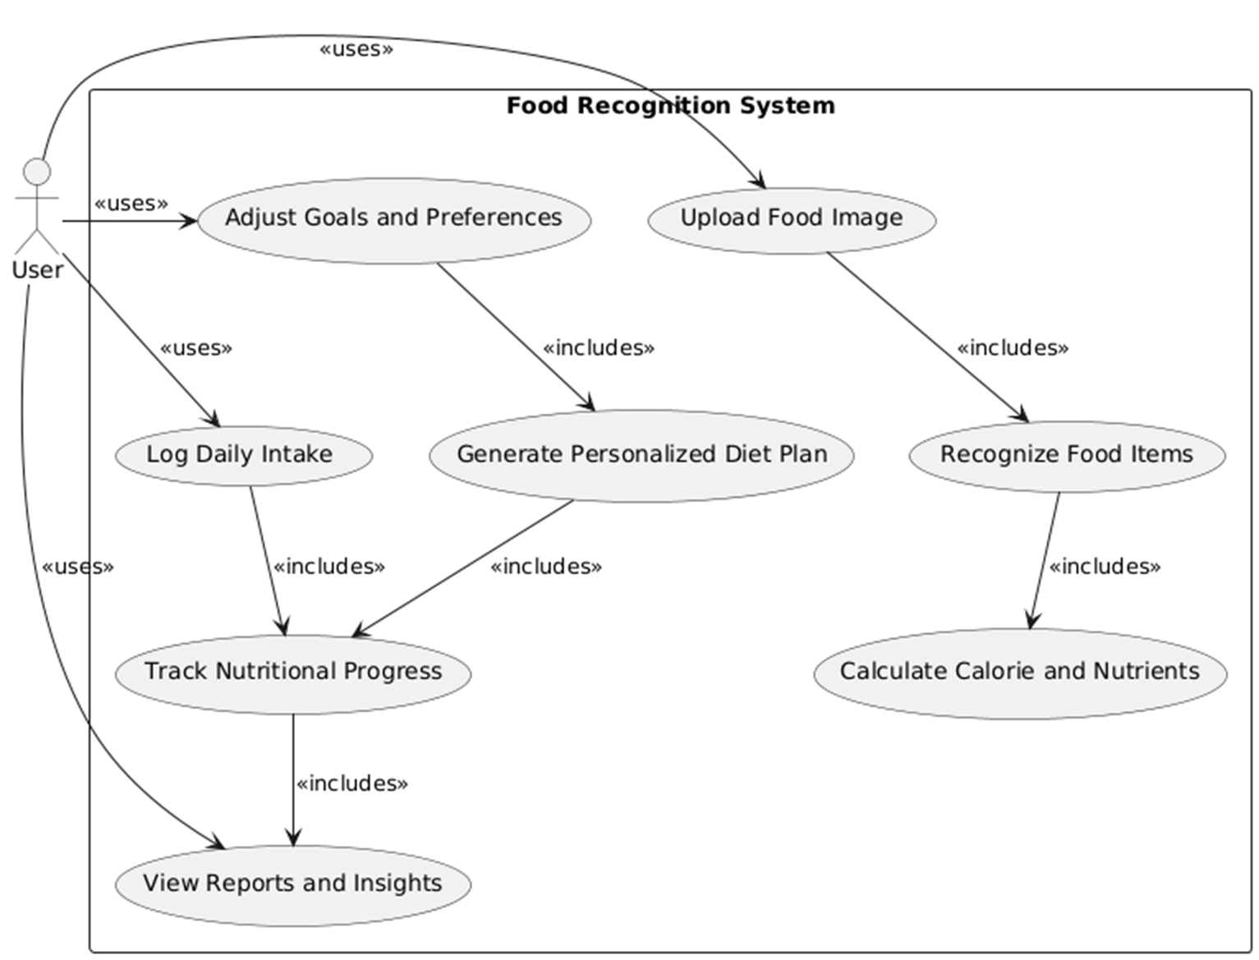
WORKFLOW
Example Workflow
User captures or uploads a meal image
System detects food items using YOLOv8
Detected items are matched with nutrition database
Calories and nutrients are estimated with portion size analysis
User data is used to generate personalized meal recommendations
Dietary intake is logged and progress is tracked
Customized goals are updated and future suggestions are adjusted

Slide 7
TARGET AUDIENCE
Health-Conscious Individuals
Fitness Enthusiasts
People with Medical Conditions
Dietitians & Nutritionists
Tech-Savvy Users & App Users
Students & Working Professionals

Slide 8
FUTURE GROWTH
Mobile App Deployment Launch on Android and iOS platforms for wider accessibility and on-the-go tracking.
Integration with Wearables Sync with smartwatches and fitness trackers to offer real-time calorie burn and intake balance.
AI-Driven Meal Planning Use advanced AI to suggest weekly or monthly meal plans based on evolving dietary patterns.
Voice-Based Logging Enable hands-free diet tracking using voice commands for added convenience.
Expanded Food Database Inclusion of regional, cultural, and traditional dishes for better global usability.
Gamification & Rewards Introduce achievements and health-based rewards to encourage user retention.
Healthcare Collaboration Partner with clinics and dieticians to offer professional insights and medical integration.

Slide 9
CONCLUSION
NUTRITRACK bridges the gap between diet tracking and AI by automating food recognition and nutrition planning. The system empowers users to manage their health with convenience and precision, promoting better lifestyle decisions.

